Slide 1
Virtual Environment
Programming languages for data science
Remote installing
CRAN PIP Anaconda/Miniconda Lab work
Module 1: Overview

Slide 2

Virtual Environment
A virtual environment is a tool that helps to keep dependencies required by different projects separate by creating them isolated with each other
Making copy from your base environment .

Slide 3
Programming languages for data science
R
PYTHON

Slide 4
Advantages of R
It’s open-source. No fees or licenses are needed, so it’s a low-risk venture if you’re developing a new program.
It’s platform-independent. R runs on all operating systems,
It has lots of packages. For example, the R language has more than 10,000 packages stored in the CRAN repository, and the number is continuously increasing.
It’s great for statistics. Statistics programmers prefer it over other languages for statistical tool development.
It’s well suited for Machine Learning. R is ideal for machine learning operations such as regression and classification. It even offers many features and packages for artificial neural network development.
R lets you perform data wrangling. R offers a host of packages that help data analysts turn unstructured, messy data into a structured format.
R is still growing. R keeps evolving and growing, constantly updating and upgrading, thanks to a solid supportive community.

Slide 5
Disadvantages of R
It’s a complicated language. .
It’s not as secure. R doesn’t have basic security measures. Consequently, it’s not a good choice for making web-safe applications. Also, R can’t be embedded in web browsers.
It’s slow. R is slower than other programming languages like Python or MATLAB.
It takes up a lot of memory. Memory management isn’t one of R’s strong points. R’s data must be stored in physical memory. However, the increasing use of cloud-based memory may eventually make this drawback moot.
It doesn’t have consistent documentation/package quality. Docs and packages can be patchy and inconsistent, or incomplete.

Slide 6
CRAN mirror (The Comprehensive R Archive )
What is mirroring in cloud computing?
Data mirroring refers to the real-time operation of copying data, as an exact copy, from one location to a local or remote storage medium
The full size of CRAN was approx 240 GB on 2020-04-24 (and Still growing all the time).
CRAN contains no dynamic pages, so in general no special configuration of your web server is needed
https://cran.r-project.org/mirrors.html (to install Base R)

Slide 7
Download R by CRAN
R is a free software environment for statistical computing and graphics.
To download R, please choose your preferred CRAN mirror.

Slide 8
PIP
The Python Package Index is a public repository of open-source licensed packages made available for use by other Python users.
the Python Packaging Authority is the group of developers They maintain a variety of tools, documentation, and issue trackers on both GitHub and Bitbucket.
The PyPA publishes the Python Packaging User Guide, which is the authoritative resource on how to package, publish, and install Python projects using current tools
https://pypi.org/

Slide 9

Downloading the RStudio and R All the programs will be installed with predefined paths: RStudio -> c:\Program Files\RStudio R Engine -> c:\Program Files\R\R-3.5.1 Both paths can be different on your machine.
Using PowerShell

Slide 10
The Environment of Statistical Computing
By
Mainak Ray

Slide 11
Anaconda/Miniconda
Conda is an open-source package and environment management system that runs on Windows, macOS, and Linux.
Conda repository features over 8,000 open-source data science and machine learning packages,
Miniconda is a free minimal installer for conda. It is a small, bootstrap version of Anaconda that includes only conda, Python, the packages they depend on, and a small number of other useful packages,

Slide 12
Git/Git_hub
Git is a free and open-source distributed version control system designed to handle everything from small to very large projects with speed and efficiency. It was developed by Linus Torvalds in 2005 for use in managing the Linux kernel development.
GitHub is a web-based platform for version control and collaboration that is built on top of Git. It provides a way for developers to host and manage Git repositories, as well as collaborate with others on projects.,

Slide 13
Map workflow

Slide 14
Installation and download
https://docs.conda.io/en/latest/miniconda.html
Git hub

Slide 15

End of Module 1

Slide 17

Statistical Hypothesis Testing
A/B testing

Slide 18
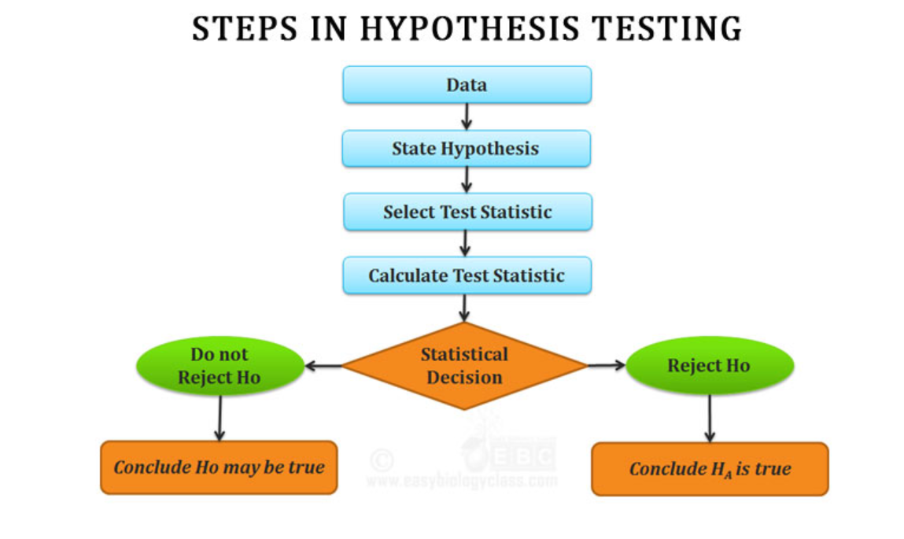
Basic Terminology
Hypothesis testing allows a greater degree of confidence in these decisions because they are not merely the mathematical differences between two samples.
A null hypothesis (Ho) assumes there is no relationship between the selected variables in a statistical study.
The alternative hypothesis (Ha) is the reverse of a null hypothesis, which means that it assumes there is a relationship between the selected variables in a statistical study.
The alpha and beta risks are also identified as a part of this statistical data analysis. Alpha risk is the risk of incorrectly rejecting the null hypothesis. Beta risk, on the other hand, is the risk of not rejecting an incorrect null hypothesis.
The p value helps to determine if the test results are statistically significant or not. In hypothesis testing, the null hypothesis can either be rejected or not rejected based on the comparison between the p value and the alpha level.
The F statistic must be used in combination with the p value when you are deciding if your overall results are significant.
Factors (independent variables, explanatory variables, manipulator variables, or risk factors.) are the variables in the study that we believe will influence the results.
When an independent variable has multiple experimental conditions, we say that there are levels of the independent variable.

Slide 19
When Do I Reject the Null Hypothesis?
Reject the null when your p value is smaller than your alpha level.
You should not reject the null if your critical f value is smaller than your F Value, unless you also have a small p-value.

Slide 20
Example
The average score of a class is 90.
However, a teacher believes that the average score might be lower.
The scores of 6 students were randomly measured.
The mean was 82 with a standard deviation of 18. With a 0.05 significance level
Use hypothesis testing to check if this claim is true.

Slide 21
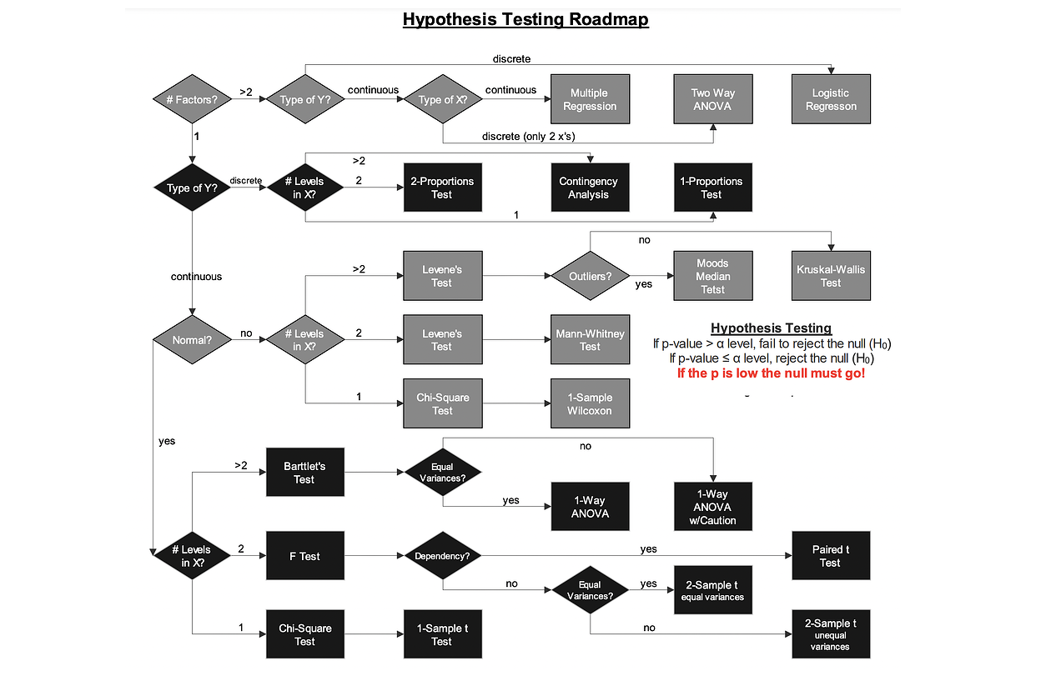
Statistical Hypothesis Testing
independent variables

Slide 22
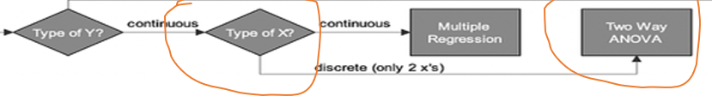
Two-way ANOVA
The primary purpose of a two-way ANOVA is to understand if there is an interaction between the two independent variables on the dependent variable.
whether there is an interaction between gender and educational level on test anxiety amongst university students,
where gender (males/females) and education level (undergraduate/postgraduate) are your independent variables,
Test anxiety is your dependent variable.

Slide 23
Example
A two-proportion Z-test is a statistical hypothesis test used to determine whether two proportions are different from each other
Two-proportion
Testing two flu drugs A and B. Drug A works on 41 people out of a sample of 195. Drug B works on 351 people in a sample of 605. Are the two drugs comparable?
A one-proportion z-test is a statistical test used to compare the proportion of a sample to a known population proportion.
One-proportion
A survey claims that 9 out of 10 doctors recommend aspirin for their patients with headaches. To test this claim, a random sample of 100 doctors is obtained. Of these 100 doctors, 82 indicate that they recommend aspirin. Is this claim accurate?
Contingency analysis seeks to evaluate a potential relationship between two categorical variables
Contingency analysis
The relationship between gender (male or female) and political party (Democrat or Republican)

Slide 24
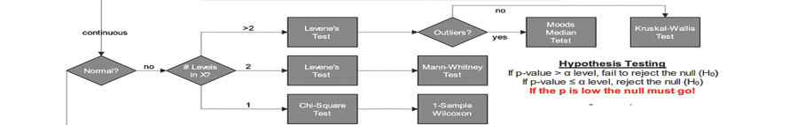
The Levene test checks whether several groups have the same variance in the population. (chk the experiments contains outlier or not)
you conducted a survey among students to find out how many cups of coffee they drink per week. Now you want to know whether the variances of the individual subjects are the same
The Mood’s median test is a nonparametric test that is used to test the equality of medians from two or more populations.
To compare the medians of machining times of different production lines in a manufacturing plant (Line 1, 2, and 3 )

Slide 26
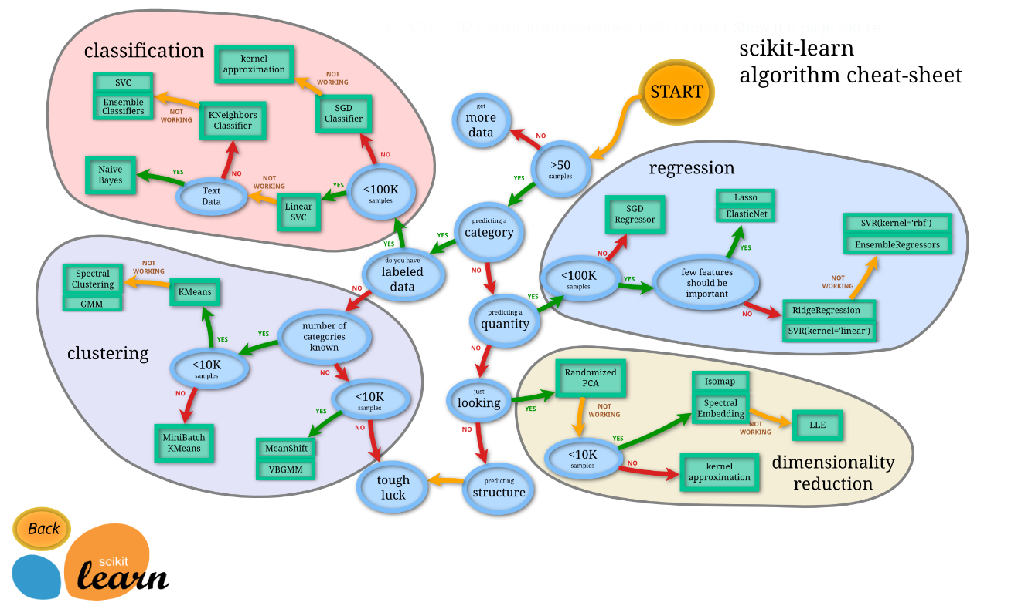

Slide 27
Assumption
Assumption #1: Your dependent variable should be measured at the continuous level (i.e., they are interval or ratio variables).
Assumption #2: Your two independent variables should each consist of two or more categorical, independent groups
Assumption #3: You should have independence of observations,
Assumption #4: There should be no significant outliers.
Assumption #5: Your dependent variable should be approximately normally distributed for each combination of the groups of the two independent variables.
Assumption #6: There needs to be homogeneity of variances for each combination of the groups of the two independent variables.

Slide 28
Elementary commands consist of either expressions or assignments
Commands are separated either by a semi-colon (‘;’), or by a newline
Elementary commands can be grouped together into one compound expression by braces (‘{’ and ‘}’).
Comments can be put almost2 anywhere, starting with a hashmark (‘#’), everything to the end of the line is a comment.
, R provides a mechanism for recalling and reexecuting previous commands. The vertical arrow keys on the keyboard can be used to scroll forward and backward through a command history
If commands4 are stored in an external file, say commands.R in the working directory work, they may be executed at any time in an R session with the command > source("commands.R")
The entities that R creates and manipulates are known as objects. These may be variables, arrays of numbers, character strings, functions, or more general structures built from such components.
objects() (alternatively, ls()) can be used to display the names of (most of) the objects which are currently stored within R
The collection of objects currently stored is called the workspace.
To remove objects the function rm is available: > rm(x, y, z, ink, junk, temp, foo, bar)
s, the objects are written to a file called .RData5 in the current directory,
the command lines used in the session are saved to a file called .Rhistory.
It is recommended that you should use separate working directories for analyses conducted with R.
. The simplest such structure is the numeric vector, which is a single entity consisting of an ordered collection of numbers
> x <- c(10.4, 5.6, 3.1, 6.4, 21.7) /> assign("x", c(10.4, 5.6, 3.1, 6.4, 21.7)) / c(10.4, 5.6, 3.1, 6.4, 21.7) -> x
> y <- c(x, 0, x) would create a vector y with 11 entries consisting of two copies of x with a zero in the middle place.

Slide 29
Vector arithmetic
Vectors can be used in arithmetic expressions, in which case the operations are performed element by element.
Vectors occurring in the same expression need not all be of the same length.
The value of the expression will be the longest vector which occurs in the expression.
Shorter vectors in the expression are recycled as often as need be they match the length of the longest vector.
c(10.4, 5.6, 3.1, 6.4, 21.7) -> x; y <- c(x, 0, x) ; v <- 2*x + y + 1
longer object length is not a multiple of shorter object length
c(min(x), max(x)). length(x) <range
sum((x-mean(x))^2)/(length(x)-1)<var(x)
sort(x) returns a vector of the same size as x with the elements arranged in increasing order;
order() or sort.list() which produce a permutation to do the sorting
maximum or minimum value of an array or a list of numbers
pmax and pmin return a vector (of length equal to their longest argument) that contains in each element the largest (smallest) element in that position in any of the input vectors.
To work with complex numbers, supply an explicit complex part. Thus sqrt(-17) will give NaN and a warning, but sqrt(-17+0i) will do the computations as complex numbers.

Slide 30
Arguments to seq(), and to many other R functions
For example > seq(-5, 5, by=.2) -> s3 generates in s3 the vector c(-5.0, -4.8, -4.6, ..., 4.6, 4.8, 5.0).
s5 <- rep(x, times=5) which will put five copies of x end-to-end in s5.
/s6 <- rep(x, each=5) which repeats each element of x five times before moving on to the next.
The elements of a logical vector can have the values TRUE, FALSE, and NA
Hence, you should always use TRUE and FALSE.
The logical operators are <=, >, >=, == for exact equality and != for inequality
y. In addition if c1 and c2 are logical expressions, then c1 & c2 is their intersection (“and”), c1 | c2 is their union (“or”), and !c1 is the negation of c1.
z <- c(1:3,NA); 1
ind <- is.na(z) find any nan value is present in the data
NA is missing value
NaN is 0/0
labs <- paste(c("X","Y"), 1:10, sep="") to prepare indexing
A factor is a vector object used to specify a discrete classification (grouping) of the components of other vectors of the same length
. R provides both ordered and unordered factors
statef <- factor(state) ; levels(statef) out put is lavel
tapply() apply a function on a data set
> incmeans <- tapply(incomes, statef, mean)
To do this you could (use tapply) once more with the length() function to find the sample sizes, and the qt() function to find the percentage points of the appropriate tdistributions. (You could also investigate R’s facilities for t-tests.)
Ordered factors The ordered() function creates such ordered factors but is otherwise identical to factor

Slide 31
Data types: Both R and Python support similar data types, including numeric, character, and boolean types. They also both support data structures like lists, arrays, and data frames.
An array can be considered as a multiply subscripted collection of data entries,
a matrix is a 2-dimensional array
if the dimension vector for an array, say a, is c(3,4,2) then there are 3 × 4 × 2 = 24 entries
As well as an index vector in any subscript position, a matrix may be used with a single index matrix
the cross product produces a vector that is perpendicular to both input vectors, while the outer product produces a matrix whose elements are the products of the corresponding elements of the input vectors.

Slide 32
x <- array(1:20, dim=c(4,5)) # Generate a 4 by 5 array
The function aperm(a, perm) may be used to permute an array, a. The argument perm must be a permutation of the integers {1, . . . , k}
A %*% B vector product
A *B vector product element wise.
x = (A−1)b /solve(a,b)

